Slide 1

ScratchyNIB
“In the rhythmic dance of ink and precision, calligraphy unveils the breathtaking beauty of written expression.”

Slide 2

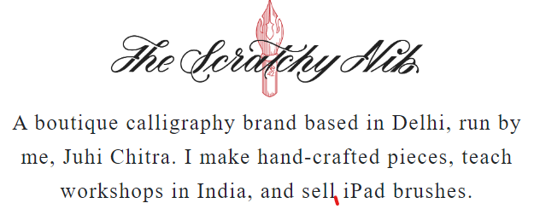

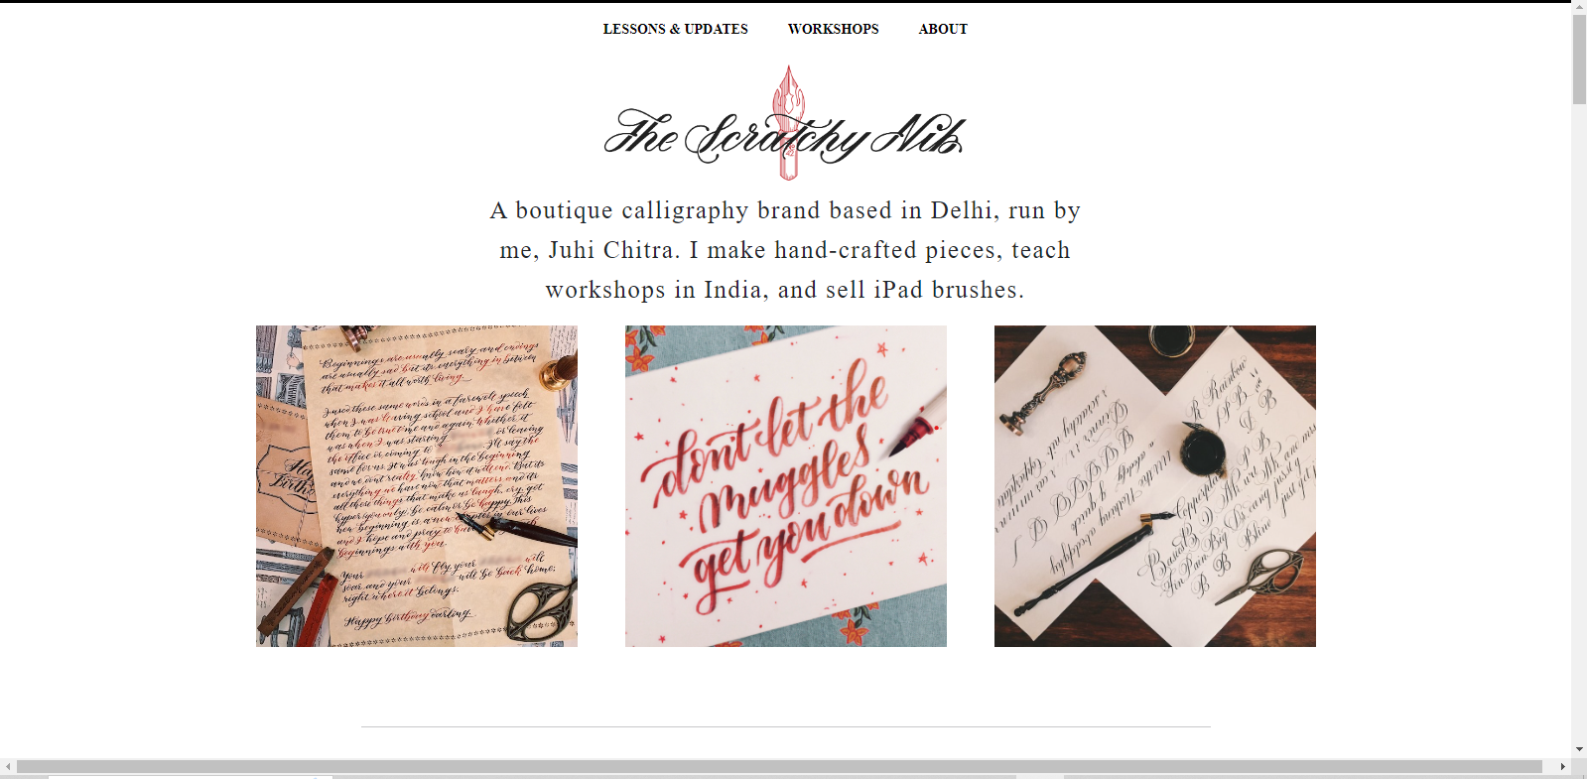
Introduction
Hello everyone!
This is our little presentation on PowerPoint. About a calligraphy website.
Like everyone got projects to build
websites on different topics,
So, we got a project to create a calligraphy website.
We have given our best out of our best in this project with devotion and enthusiasm. But due to this project, we have learned a lot. Besides, we've faced a lot of difficulties as well.
This website is a duplicate version of the real one. This website is not that too much perfect. But we've tried our best as we are still in our learning journey.
✎﹏﹏﹏﹏﹏﹏﹏﹏﹏﹏﹏﹏﹏﹏

Slide 3

Home page Of Scratchy NIB
“ We have divided this homepage in various screenshots. And all of them have described according to screenshots.”

Slide 4

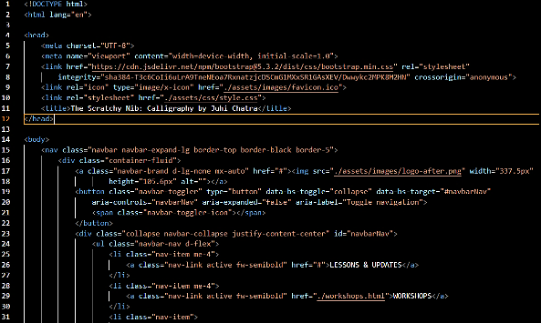
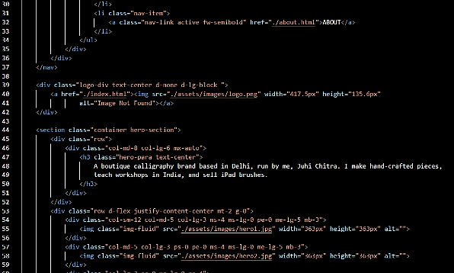
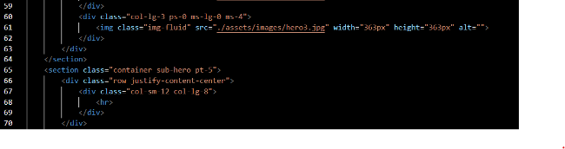
Home Page First Screenshot
So, this is the screenshot of the home page. At the beginning of the website, we've created a navbar in which we've added three list items like lessons and updates, workshops, and about. And three of them are responsive. After that, the scratchy nib logo image, the text after the logo, and the images. We've taken all these pictures and logos from their original website. For further details, we've shared our screenshots of the code. ‿︵‿︵‿୨ ୧‿︵‿︵‿

Slide 5
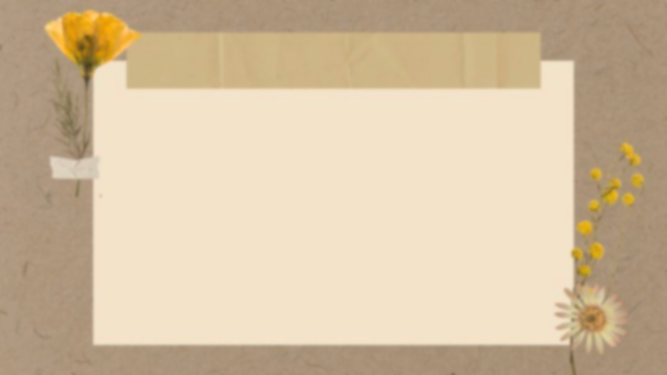
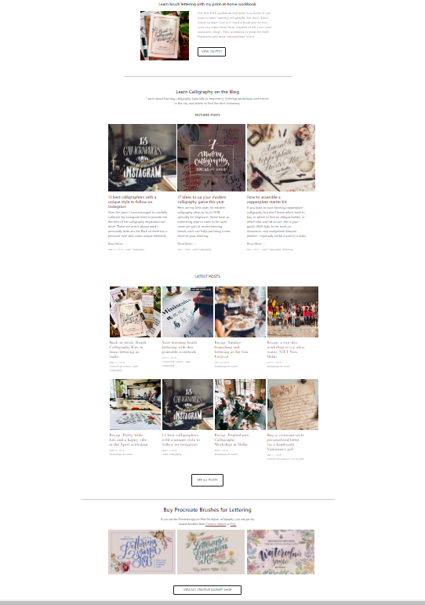
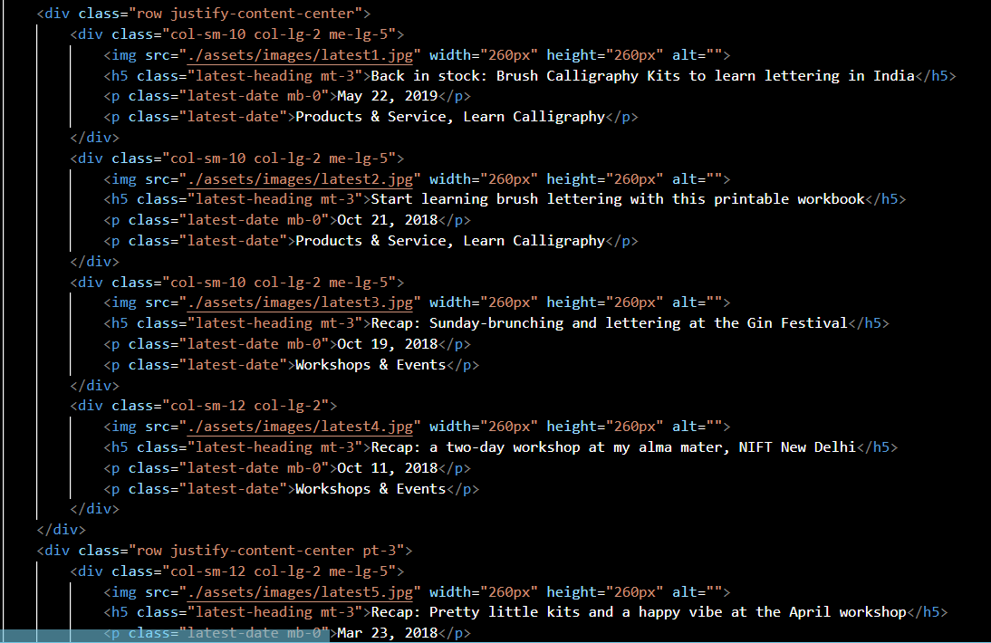
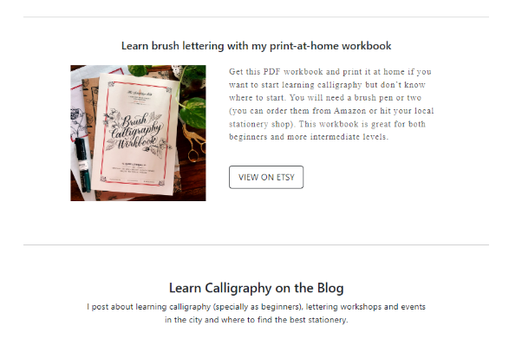
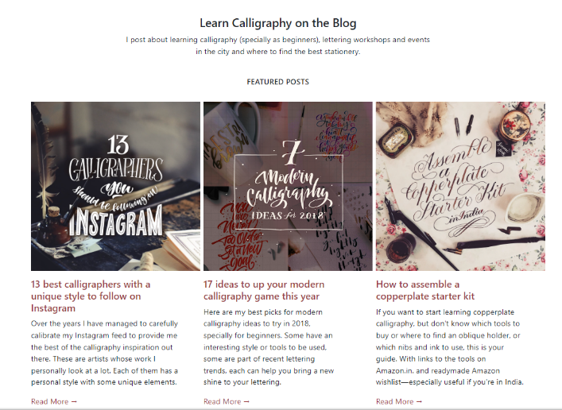
2nd screenshots of home page
The second screenshot of home page. Nothing very special again in this , we have taken some pics of their website, which has calligraphy ideas some information's and also some buttons which are linked with their Instagram pages or any other webpage. We have tried to give it the same style as the original one. But these buttons are not responsive it contains the random links. Only our navbar is responsive cuz it links the website. ✑┈┈┈┈┈

Slide 6

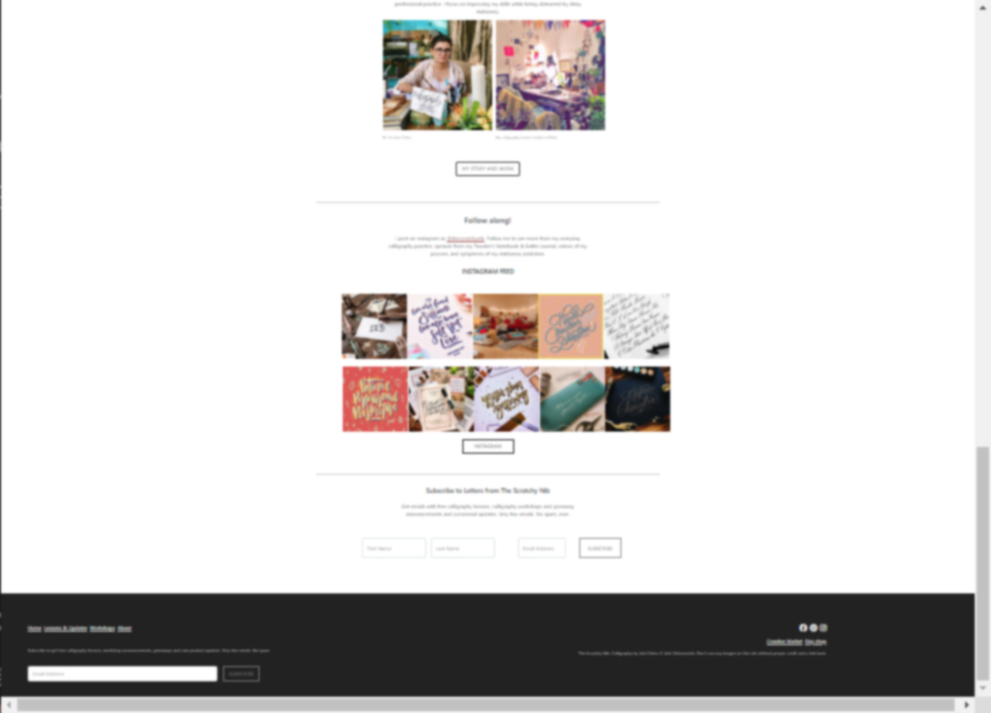
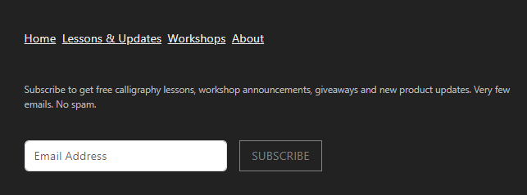
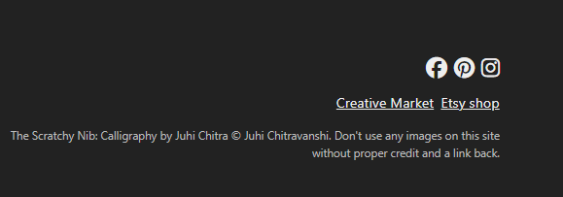
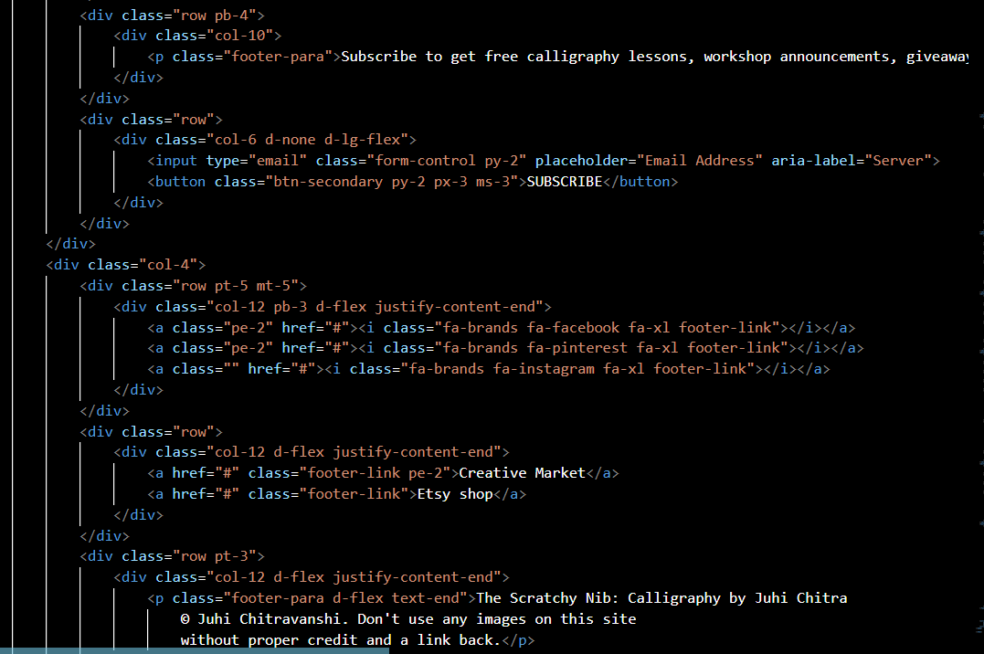
Final Screenshots Of Home Page
About Footer Part
Last but not least is the page footer.
We've keep it as simple as possible. Just like the original
one
How many elements have we added in it?
Some links like home ,lessons & updates , workshops, about, creative market and Etsy shop
A Placeholder and Subscribe button.
copied text & Lastly three icons

Slide 7
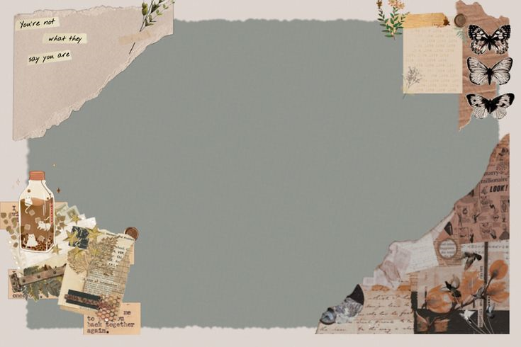
Workshops Page Of Scratchy NIB
“ Here are some screenshots of workshops page of our website Scratchy NIB “

Slide 8

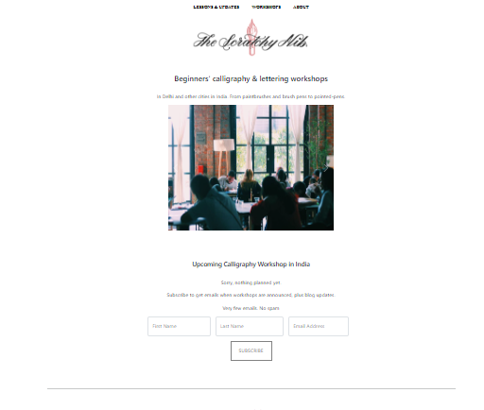
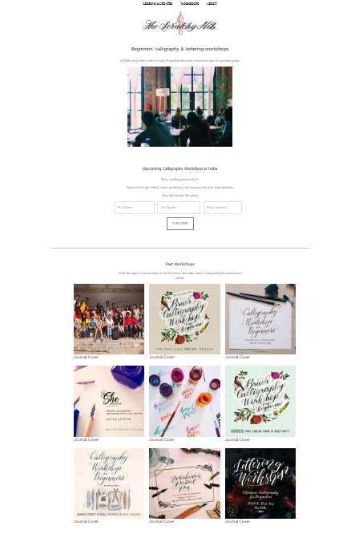
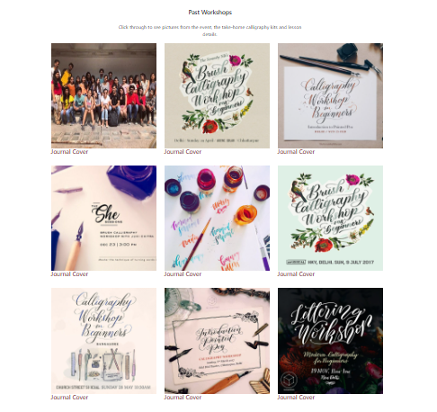
Workshop Page
What we have created on this webpage?
Same navbar.
Same Logo
Three placeholders first name, last name, & Email address.
Subscribe button
Some images of journal cover.
And same footer.
.・゜●・・●゜・．

Slide 9
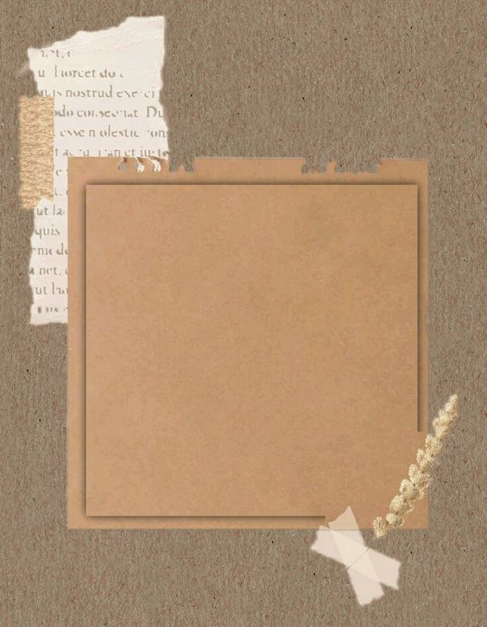
About Page Of Scratchy NIB
“Next Slide is for About Page and its details “
•,.·•' '•·.,•

Slide 10

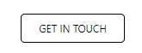
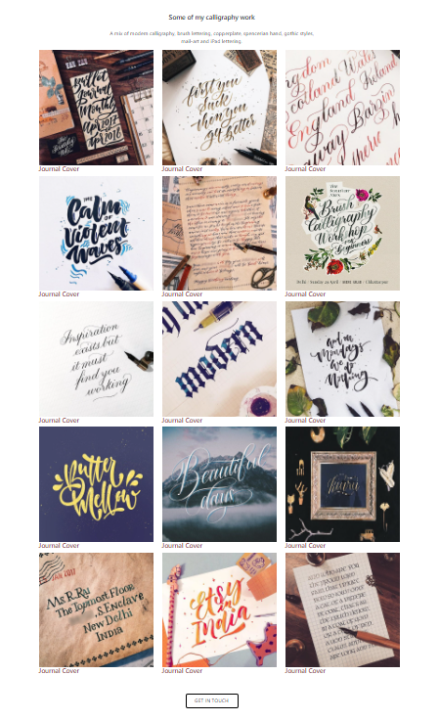
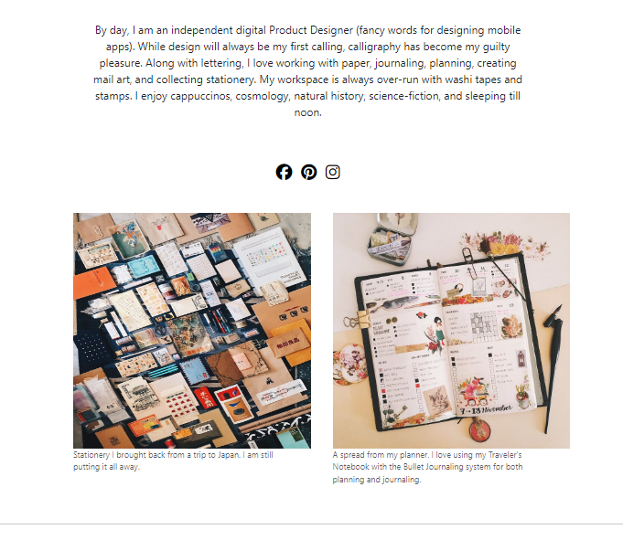
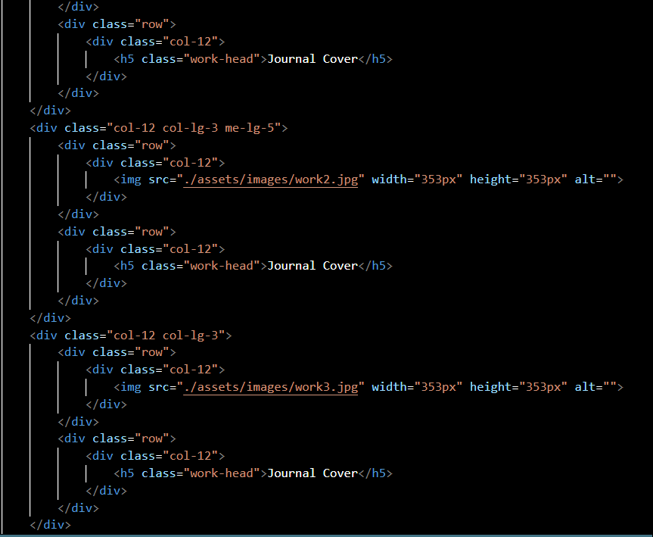
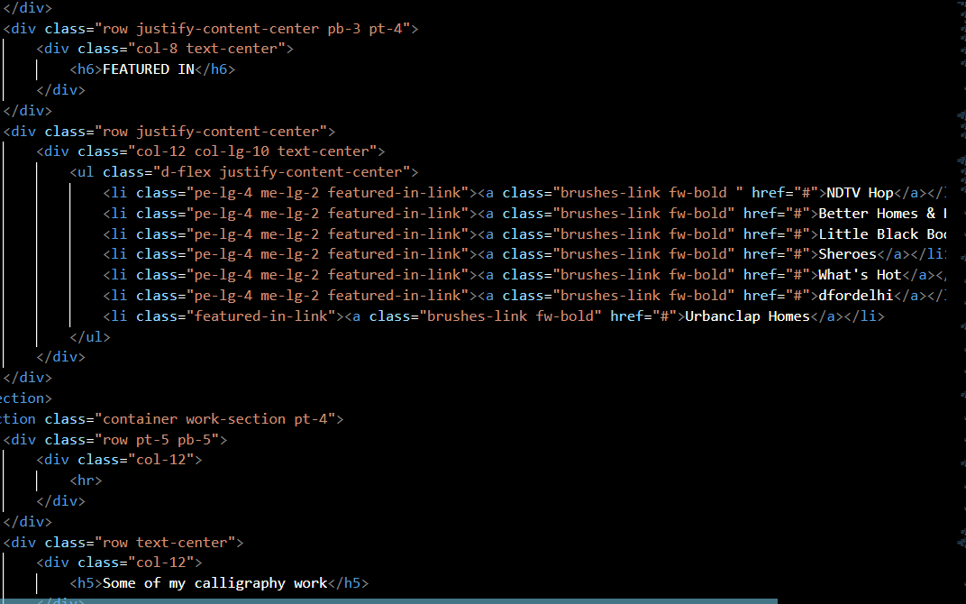

Slide 11
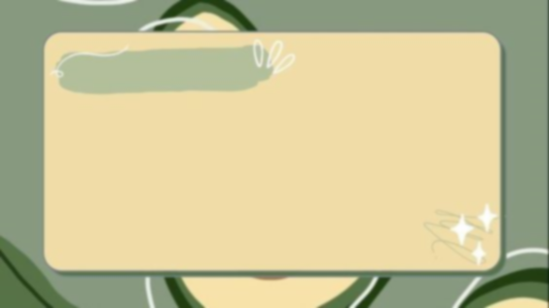
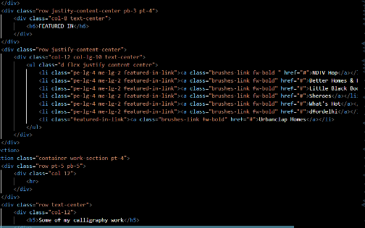
About page
Parts of About page
Logo
images of journal covers
Button some links and footer
.·:••●••:·.

Slide 12
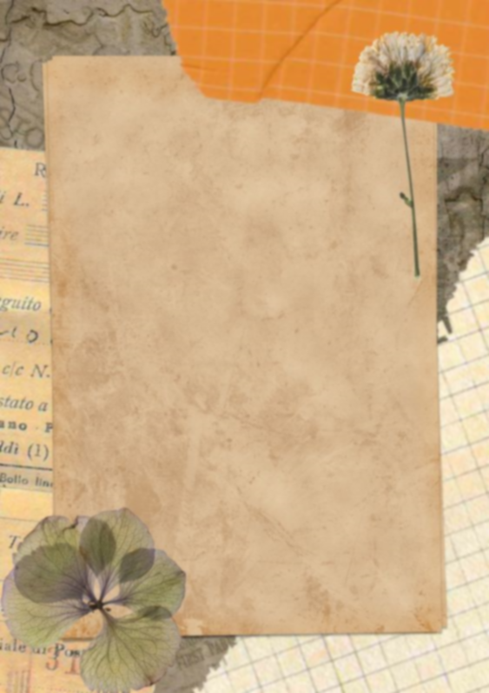
Lessons and Updates page of scratchy NIB
“ Screenshots of Last page of our website”
.・゜●・・●゜・．

Slide 13

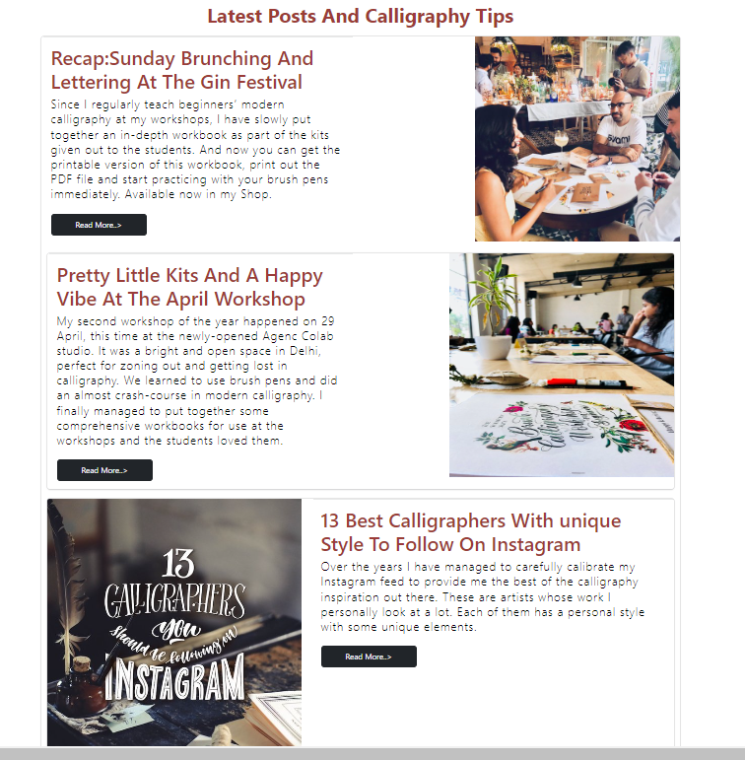
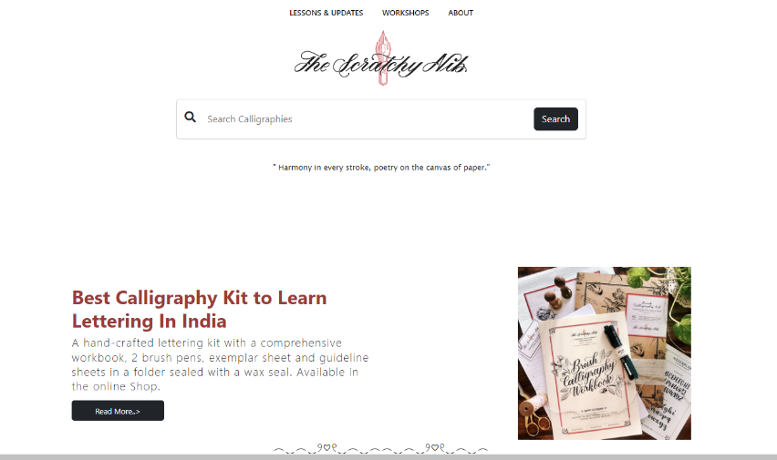
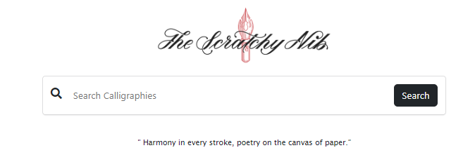
Lessons And Updates
About Lessons and Updates
In this page We’ve created.
A search box and card container.
And few buttons.
Tooltips (with the help of BootstrapV5.3).
━━━◕‿↼━━━

Slide 14
The End
“ That’s all about our website. Thanks for watching our presentation hope you’ll like it!. ”

